Slide 1
Best iDevice Apps
Jere Minich
Board of Advisors
Region 5

Slide 2
What I will/not Cover
Will Cover
Apps that I personally use on my iPad/iPhone. (16)
Apps that are listed as +Universal for iPad/iPhone.
Will NOT Cover
All Free Apps.
Apps that deal with Finance.
Apps that have a negative review.
All features of Apps in presentation.
Resource at the end of the Power Point presentation.

Slide 3
LastPass Intro
PC, iPad, iPhone, Apple watch, & Android Smartphones, Tablets.
A great password manager on desktop PC’s.
Also features mobile support for subscribers to LastPass's premium service.
The LastPass app is a password vault, strong password generator & browser all rolled into a single mobile app.
Users can:
sync their password vaults,
automatically fill in forms & login details when surfing the Web & accessing sites.
The service lets you use a master password, or Touch ID to access your vault & login.

Slide 4
Last Pass – Pros / Cons
Generates & stores unique, complex passwords.
Excellent Touch ID integration.
Autocompletes Web forms.
Shares passwords securely.
Encrypted notes.
Works with Apple Watch.
Cons
No support for fill forms outside of LastPass browser.
Bottom Line LastPass lets you create, store, & recall complex passwords for each & every app & website that requires one. This app goes a long way toward improving your personal security.

Slide 5
Last Pass - Pricing, Setup, & Interface
Available as a free download from the App Store
There are Premium accounts available for LastPass
LastPass syncs passwords with any number of devices of the same type for free, forever.
If you create your account on a phone, you can retrieve your passwords from any other phone for free,
but not from the desktop app or a tablet.
Premium accounts cost only $12 a year.
For the complete rundown: https://lastpass.com/

Slide 6
IMDB App (Internet Media Data Base)
Any Device with a Browser
A comprehensive database of information on:
movies,
TV series,
actors & actresses,
directors,
Movies in Theaters -screen times & trailers
production credits & more.
Need to look up the details of an obscure film.

Slide 7
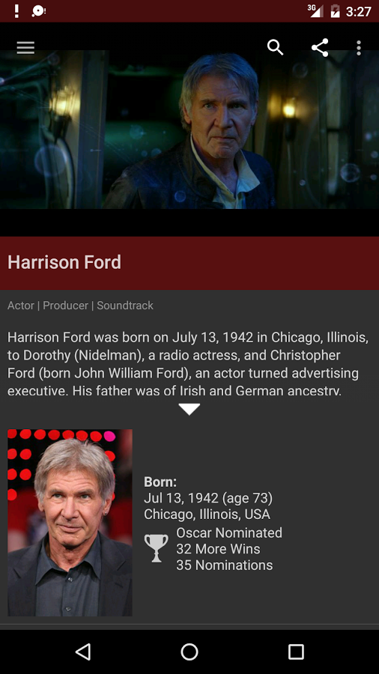
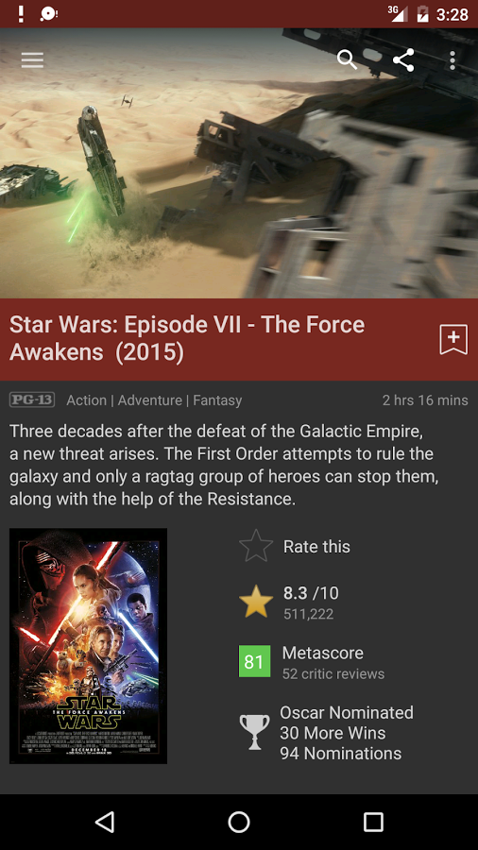
IMDB
Screenshots

Slide 8
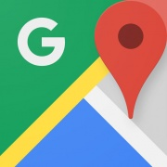
Google Maps
PC, Smartphones, Tablets
Most consistent, feature packed & useful online navigation
tools available.
iOS app comes packed with:
excellent local business & address search,
turn-by-turn navigation,
Street View & other features.
Works with: some stand-alone GPS units, including: BMW, Audi, Infinity, Mercedes-Benz, Toyota.
Works with dedicated GPS devices: Garmin, Clarion, Pioneer, NAVIGON, insignia Mio/Navman.
Units must have either a cellular data connection or a USB connection & the Garmin Communicator browser plugin.

Slide 9
Google Maps - App Description
Get there faster with real-time updates
Beat traffic with real-time ETAs & traffic conditions
Catch your bus, train, with real-time transit info
Save time with automatic re-routing
based on live traffic, incidents, road closures
Don't miss a turn or exit with lane guidance
Find stops along your route like:
gas stations & coffee spots

Slide 10
Google Maps – Discover places & explore like a local
• Find top-rated restaurants & local businesses. • Decide on the best places to go with:
reviews, ratings, & pictures of foods & interiors.
Plan your visit & see menus, make reservations, & find when places are typically busiest.
Help others discover the best places by sharing reviews, photos.
Save places you want or often visit, & quickly find them later from any computer or device.

Slide 11
Experience the Google Maps difference
• Offline maps to search & navigate without an internet connection. • Street View & indoor imagery for restaurants, shops, etc. • Indoor maps - find your way inside places like:
airports, malls & stadiums.
Transit schedules & maps for over 15,000 cities
Detailed business information on over 100 million places * Some features not available in all countries

Slide 12
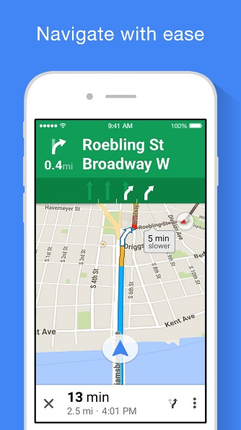
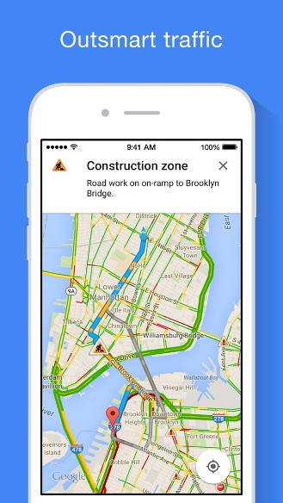
Google Maps
Screenshots
iPhone

Slide 13
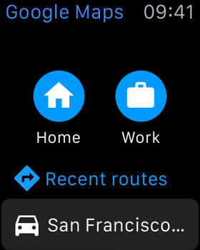
Apple Watch
Screenshots

Slide 14
TED App
List on 3rd Screen.
Mobile Devices.
The motto of the TED conferences is "Ideas worth spreading,"
The official TED app makes it easy to do just that.
You can download & view more than a thousand TEDTalk videos.
Featuring some of the best & brightest talking about ideas they believe matter, whether it's:
art, design, philosophy, philanthropy, technology.

Slide 15
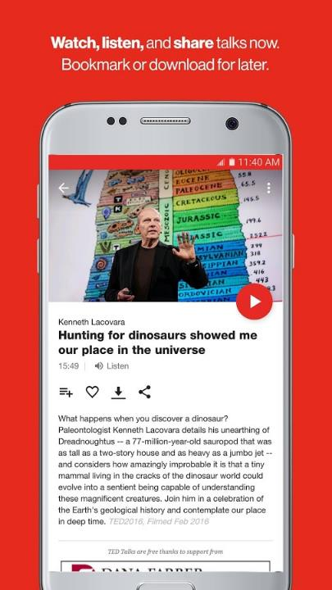
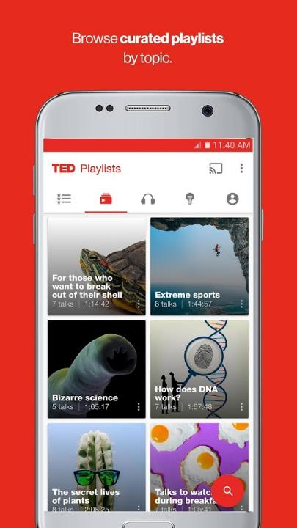
TED App Screenshots

Slide 16
TED - Distribution partners
NPR TED Radio Hour, TED Radio Hour,
iTunes podcast, iPad & iPhone,
Android , Amazon Fire TV,
Chromecast, Xbox One,
Android TV, Apple TV,
Roku, Samsung Smart TV.

Slide 17
Gmail - email from Google
+ Universal App, Smartphones, tablets.
Google's webmail service on the go,
Allowing users to switch between five accounts logged in simultaneously.
Receive real-time notifications from Gmail:
a variety of organizational features such as:
threaded conversations,
Google Calendar integration,
Client email,
Etc.

Slide 18
Gmail - App Description
real-time notifications,
multiple account support,
Switch between up to 5 accounts,
Predictions as you type,
Read your mail with threaded conversations,
Auto-complete contact names as you type from your Google contacts,
Respond to Google Calendar invites,
Read & respond to interactive Google+ posts,
Organize your mail by archiving, labeling, deleting & reporting spam,
Send & receive attachments,
Customize emails with custom scribbles.

Slide 19
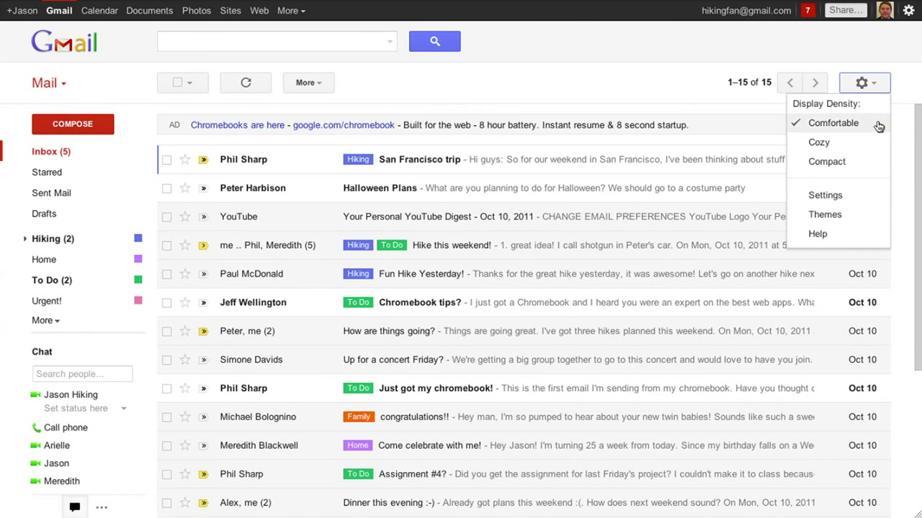
Gmail Screenshot

Slide 20
Kindle App
PC, Smartphones, MAC, Blackberry, WebOS, Windows
A powerful multi-platform reading app.
Tweak the app's text display, backgrounds & more.
Access books purchased through the Kindle marketplace.
Build your own library: • Read a sample of any book before adding to library, • Share your books with Family Library. • Get popular magazines & newspapers.
Textbooks with high-resolution color images.
Go to local library, check out an eBook, delivered wirelessly.

Slide 21
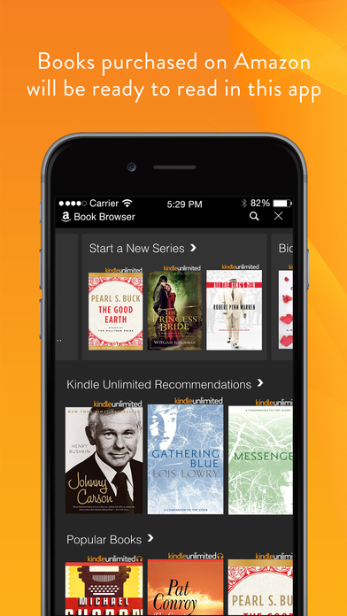
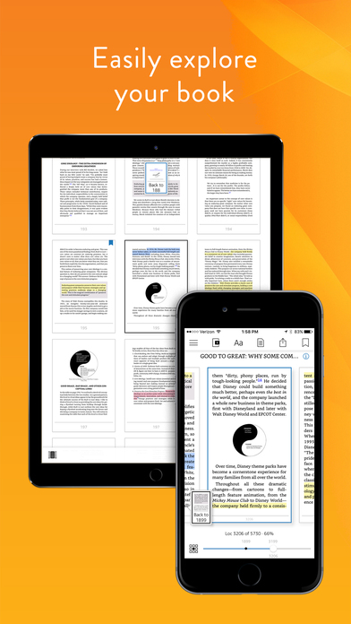
Kindle App Screenshots

Slide 22
Amazon App: shop, browse, scan, compare, & read reviews
iPad, iPhone, Apple Watch
Comprehensive -Browse, search, get product details, read reviews & purchase millions of products available from Amazon.com & other merchants. Convenient
Sign in with your existing Amazon account to access your cart, payment & shipping options.
Create or find a baby or wedding registry.
Manage your 1-Click settings & wish lists.
Track your orders & use your Prime membership benefits.
Shop just as you do on the web.

Slide 23
Amazon App
Fast
Compare prices & check availability instantly by scanning a barcode, snapping a picture or typing your search.
Apple Watch customers use their voice to search for products:
buy with 1-Click & build a shopping list on their watch. Secure
All purchases are routed through Amazon's secure servers.

Slide 24
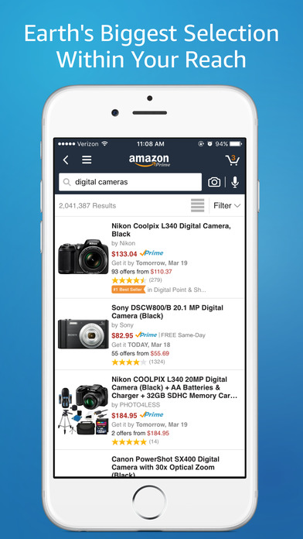
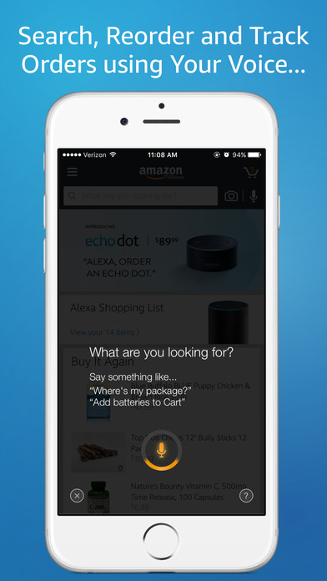
AppleWatch
screenshots
iPhone Screenshots

Slide 25
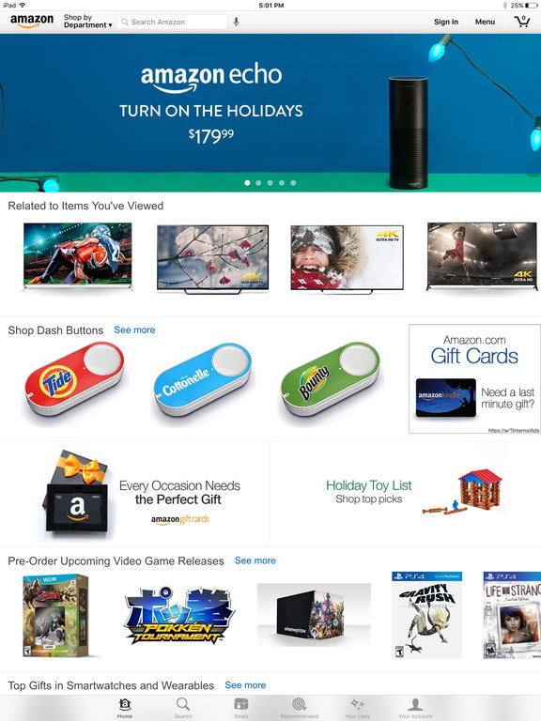
Amazon App iPad Screenshot.

Slide 26
Waze - GPS Navigation, Maps & Social Traffic
iPad, iPhone
App Description
Community-based traffic & navigation app.
Join drivers in your area who share real-time traffic & road info.
Actively report accidents, police traps & other hazards on the road.
Get road alerts along your route & find the cheapest gas prices.
Add friends, send locations or keep others posted on your arrival time.
Turn-by-turn voice guided navigation
Live maps, consistently edited & updated.

Slide 27
Waze
- Automatic rerouting as conditions change on the road.
Send your ETA & real-time drive time to update meeting.
Learns your frequent destinations, commuting hours, & preferred routes.
Find the cheapest gas station on your route.
Add information on local places & businesses.
Add Facebook friends & sync Contacts.
Note: Continued use of GPS running in the background can dramatically decrease battery life.
Waze will automatically shut down if you run it in the background & haven't driven for a while.

Slide 28
Waze - Features
Elvis Guiding Drivers Home Safely - listen to the voice of Elvis Presley guiding them home safely. (other voices available)
Syncing Calendar Events thus Creating Route Plans - you succeed in creating a list of not only all the available appointments, but also their proper locations.
Getting Gas - Main Menu > Navigate map > Gas.
a list of all the gas stations that are near your current location.
a list of the prices at these gas stations.
Hate tolls? How about driving the back routes?
Go into: Settings > Navigation.
customize your route to lose the tolls, the dirt roads, or even the freeways.

Slide 29
Waze Features
Customize what you see on your route. Don’t want to see all the other Wazers on the road ?
Turn them off: Settings > Display Settings > Show On Map.
You can be Good & help other Wazers out- Are the fuzz out in force? Did you spot a speed camera that others should know about?
I don’t advise doing this while you’re driving, but if you have a passenger with free hands:
tap the button on the lower-right corner of the main screen.
A Report screen will pop up.
Report the road feature of your choice.
It gets broadcast to other Wazers in the area.

Slide 30
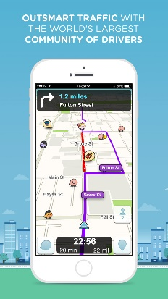
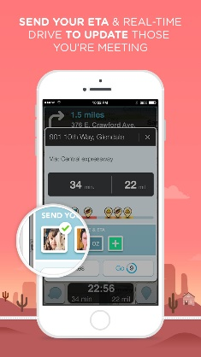
Waze iPhone Screenshots

Slide 31
QR Reader - iPhone
Designed for iPhone, compatible with iPad
App Description
Simple & easy QR Reader - 100% FREE. Now scans QR codes, barcodes, puzzles, business cards & documents. FEATURES - Code Scanner - scans QR codes & barcodes - PDF Scanner - turns your iPhone into a digital scanner - Business Card Scanner - scans business contacts - Puzzle Scanner - scan & play puzzles - Browse products, deals & coupons - Auto-detect scanning. Simply point & hold - Create your own QR codes - Export your scans by CSV (Comma Separated Values)

Slide 32
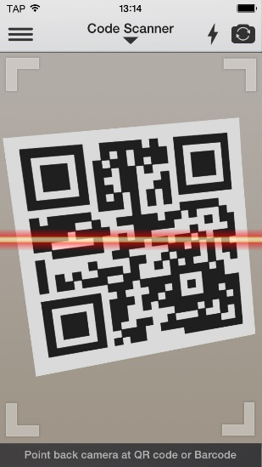
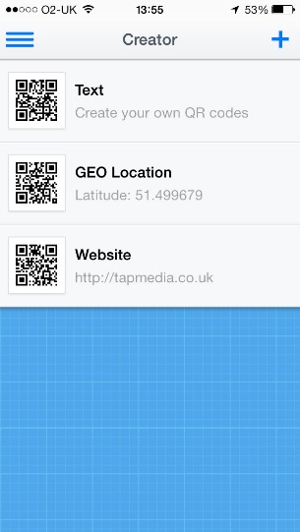
QR reader iPhone Screenshots

Slide 33
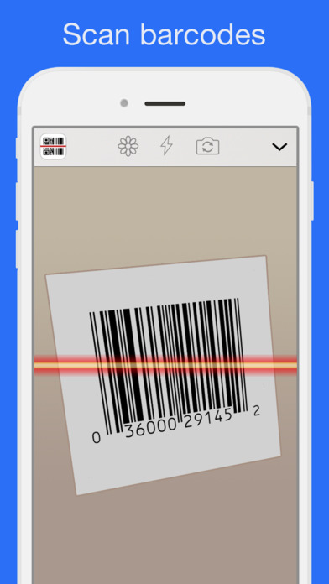
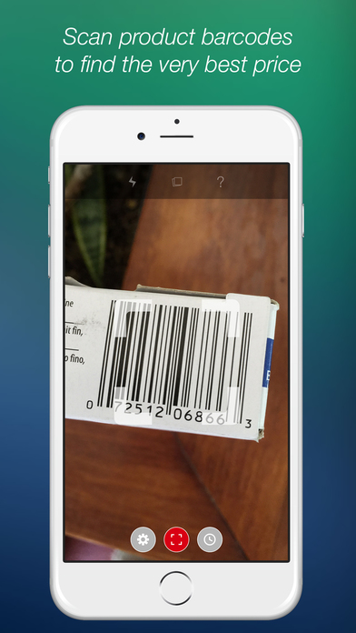
QR Reader Screenshots -
iPhone

Slide 34
Starbucks App
Designed for iPhone & Apple Watch, compatible with iPad
App Description
A fast, convenient way to order & pay.
Order ahead & pick up your drink without waiting in line.
Rewards are built right in, so you’ll collect Stars & start earning free drinks & food with every purchase.
iOS exclusives:
Apple Watch app;
TouchID to reload Starbucks Card with Apple Pay or any credit/debit card;
3D Touch to jump to Pay, Order & Reload from your phone’s home screen (limited device use).
Tip your barista digitally.

Slide 35
Starbucks added features
Pay for your order.
Earn & track Star Rewards.
Place a customized order & pay ahead with Mobile Order & Pay.
Discover what songs are playing in our stores.
Check your balance.
Add funds to your Starbucks Card (with debit/credit card, Visa Checkout, PayPal or Apple Pay)
Send gift cards.
Use Apple Watch to pay, track rewards & more.

Slide 36
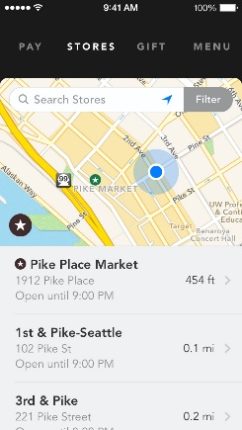
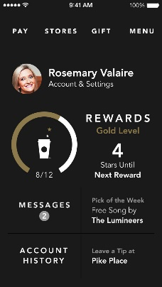
Starbucks Screenshots iPhone

Slide 37
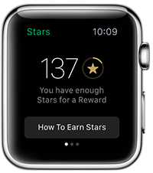
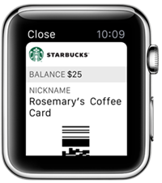
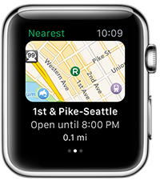
Track Rewards
Pay
Find Stores
Starbucks Apple Watch Screen Shots

Slide 38
XFINITY TV
+ Universal & Apple Watch App - iPhone, iPad & Apple Watch
App Description
All your TV, all in one place.
Stream live TV & XFINITY on any device at home or on the go.
Download XFINITY TV on your mobile devices.
If you’re an X1 customer, also stream or download your cloud DVR shows to your device & watch anywhere.
X1, experience TV & Internet together with advanced search, personalized recommendations, apps at home, fastest in-home Wi-Fi for all rooms, all devices, all the time.
(internet required)

Slide 39
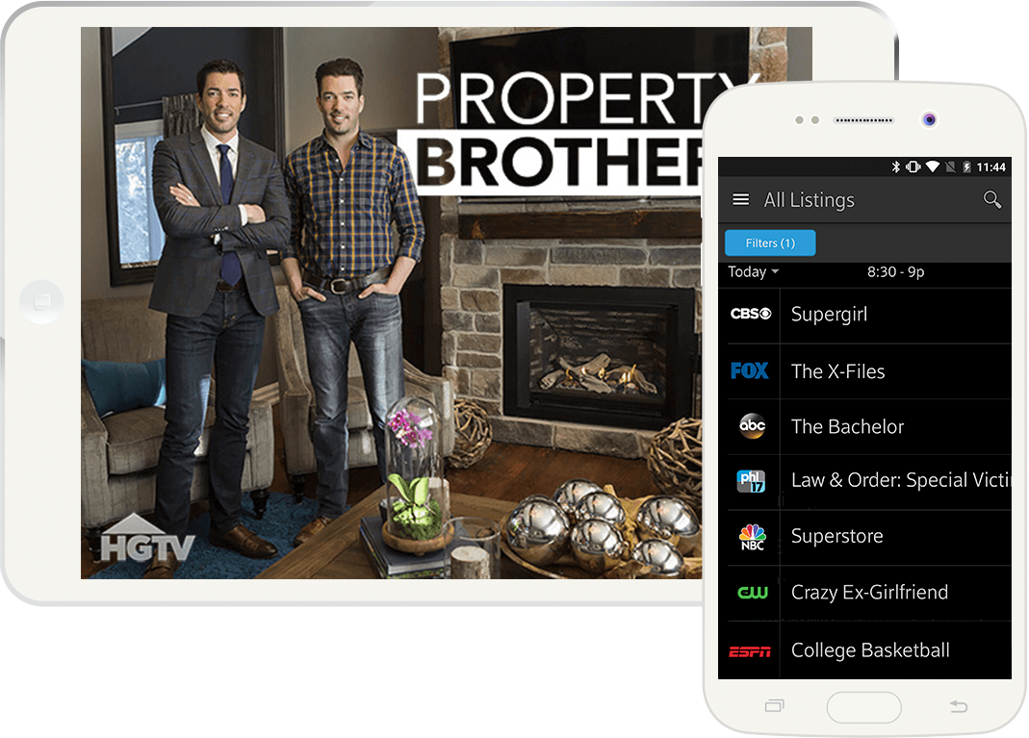
XFINITY Screenshots iPad & iPhone

Slide 40
Bible App
+ Universal & Apple Watch App - iPhone, iPad & Apple Watch
Over 1,000 Bible versions
READ THE BIBLE * Easily select from hundreds of Bible versions. * Offline Bibles: Read even without internet access
(available for select versions).
Listen to audio Bibles
enjoy all-new skip, playback speed, & timer controls.
(Audio Bibles available for select versions & are not downloadable).

Slide 41
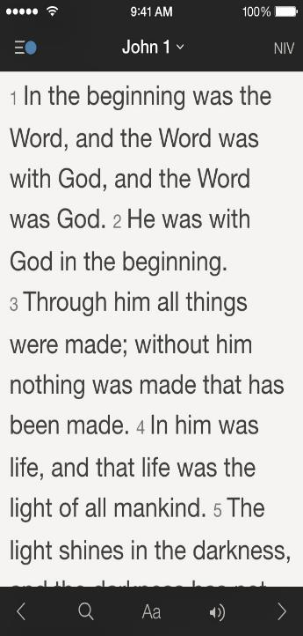
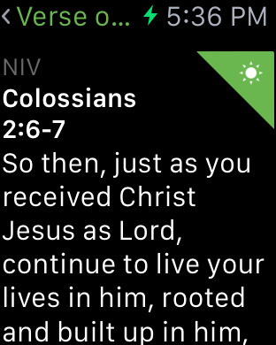
Apple Watch
iPad
iPhone
Bible Screenshots

Slide 42
Google Earth
+ Universal App
iPhone & iPad
App Description
Fly around the planet with a swipe of your finger.
Explore distant lands or reacquaint yourself with your childhood home.
Search for cities, places, & businesses.
Browse layers including roads, borders, places, photos.
See the world at street level with integrated Street View.
Use the “tour guide” to easily discover exciting new places to explore.
With a quick swipe on the tab at the bottom of the screen, you can bring up a selection of virtual tours from around the globe.
With 3D imagery, fly through complete 3D recreations of select cities.

Slide 43
Google Earth Features
Enter Address & Location = findyourmaps.com
For Live Satellite, Earth & Street Views & More w/Free Maps Toolbar.
Street View My House = hdstreetview.net
Enter Any Place For Street View Find Street View Of My House.
View Navigation = mytransitguide.com
Step 1- Click Here Step 2-Download Step 3- Get Maps w/ MyTransitGuide
Go to: https://www.google.com/earth/learn/ for tutorials.

Slide 44
Google Earth - more features
Exploring History & Civilization
The Progression of Light – Follow the Sun
Deadly Accurate Distances
Send Friends Aerial Views
Explore the Sky
PhotoOverlays
Keyhole Markup Language (KML) notation for expressing geographic annotation & visualization within Internet-based, two-dimensional maps & three-dimensional Earth browsers.

Slide 45
Google Earth – Pro
The full list of Google Earth Pro features are listed below:
Movie Maker Integration.
Geographic Information System (GIS) data import tools.
High-resolution printing capability.
US parcel, demographic & traffic data layers.
Auto gen - of "superoverlays" for very large image files.
Auto region gen - large point & vector datasets.
Area measurement.
Google Earth Pro = free ( it use to be $399.)

Slide 46
Google Earth - Beginner Tutorials
Street View
3D Trees
Historical Imagery
Navigation
Searching for Places
Drawing & Measuring
Placemarks & Tours
Exploring Mars, Moon & Sky
Moon in Google Earth
Sharing Google Earth screenshots
Tour Guide

Slide 47
Google Earth – More Tutorials
Advanced Tutorials - Recording a Tour, Importing KML, KMZ & GPS Data, Geotagging Photos.
KMZ = Keyhole Markup language Zipped. It is a compressed version of a KML
3D Buildings Tutorials - Intro to Google Building Maker, Create 3D models with SketchUp, Geo-modeling with SketchUp & Building Maker, Modeling with Site Context.
More Tutorials - Tutorials for Non-Profits, Tutorials for Educators, KML Tutorial, More Tutorial Videos on YouTube.

Slide 48
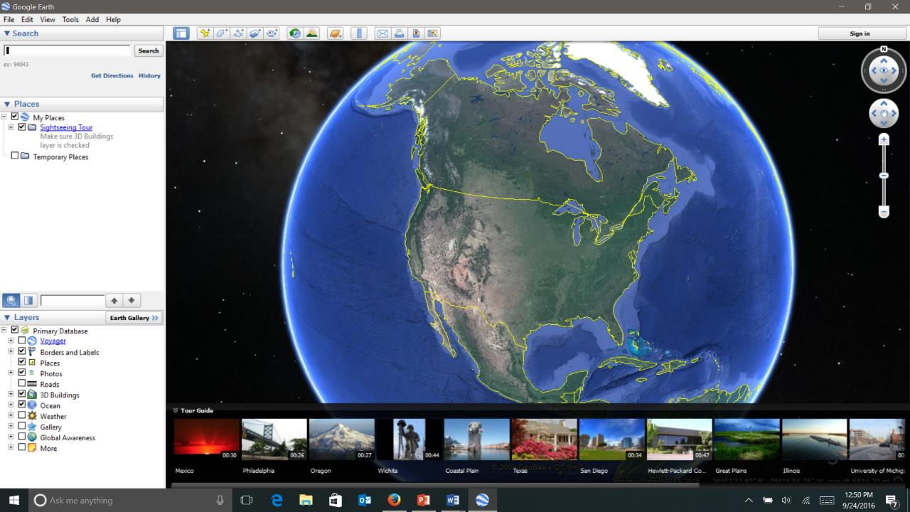
Google Earth Screenshot

Slide 49
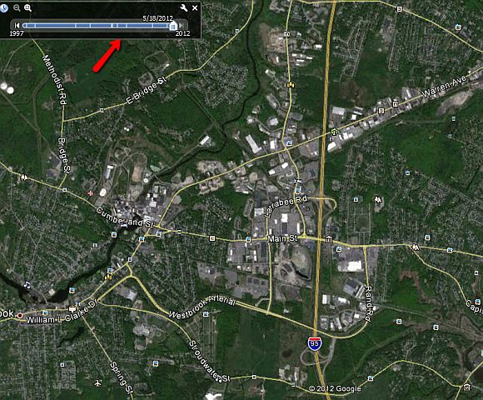
Google Earth shows population growth.
Through its “historical imagery” tool, which you can access under:
View -> Historical Imagery.
Google Earth Pro Screen Shot

Slide 50
Measure the Distance –
Between multiple points on the ground.

Slide 51
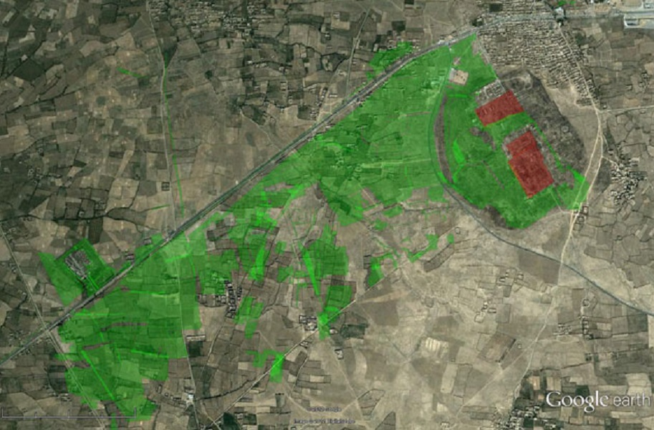
Google Earth Pro Screenshot
Measurement of the land coverage in green

Slide 52
DIRECTV App
iPhone & Apple Watch App - compatible with iPad
App Description
Watch Live TV, catch up on the latest movies & shows with On Demand, & schedule recordings on your DVR!
WATCH • Thousands of your favorite movies & shows, Live or On Demand. • Enjoy the latest releases from premium channels you subscribe to like HBO, Cinemax, STARZ, ENCORE, & SHOWTIME
• Switch screens! Watch your favorite show on one device
Tap a button to send it to the big screen.
& vice versa—send a show from your TV to your device.
When one episode ends, the next episode begins automatically!

Slide 53
DirectTV – App Description
RECORD • Record your favorite movies & shows from anywhere. • Add extra time to your recording. CONTROL • See what’s playing on your TV, control playback, set your DVR.
Use Apple Watch to control your TV.
Find new movies & shows,
View their details,
Set them to record to your DVR.
Use Voice Search to help you find what you're looking for.

Slide 54
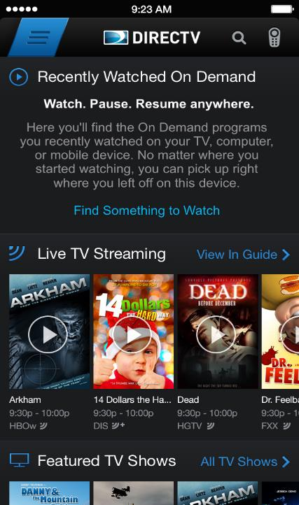
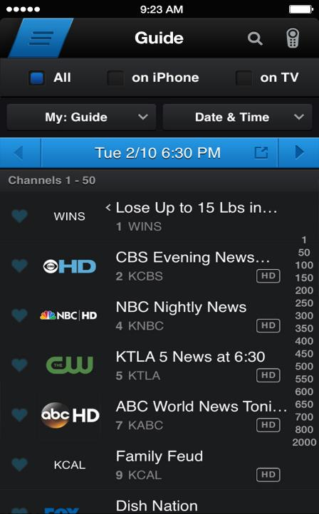
Direct TV Screenshots iPhone

Slide 55
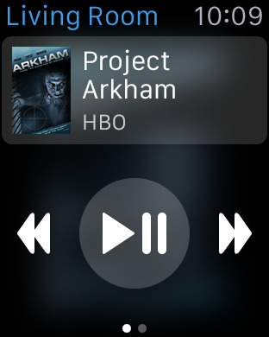
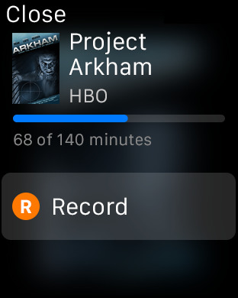
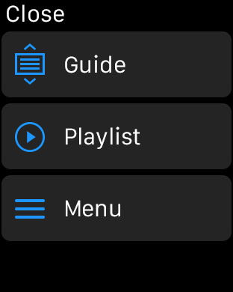
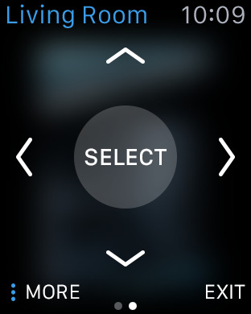
Direct TV Screenshots
Apple Watch

Slide 56
Amazon Video App
+ Universal App –
iPhone & iPad
App Description
Prime members - instantly stream tens of thousands of movies & TV episodes.
Including award-winning Amazon Original Series
Select titles are available to download for offline viewing.
Access & stream SHOWTIME, STARZ, & dozens more subscriptions.
Access titles you bought or rented on Amazon from the catalog.
Stream or download to your iPhone, iPad.

Slide 57
Amazon Video App – additional features
The ability to download titles for offline viewing.
Stream movies & TV shows over Wi-Fi or Cellular tower.
Watch on your Apple TV using AirPlay.
Watch on your TV using HDMI & your Apple Digital AV Adapter.
Stream the first episode of selected TV shows for free.
(include advertising before & during your videos)
Add videos to Your Watchlist from any Amazon Video compatible device for later viewing on your iPad, iPhone.
View IMDB data about the actors, songs & trivia related to your videos during playback with X-Ray.
Start watching the next episode of the show you are currently streaming automatically with Auto Play.

Slide 58
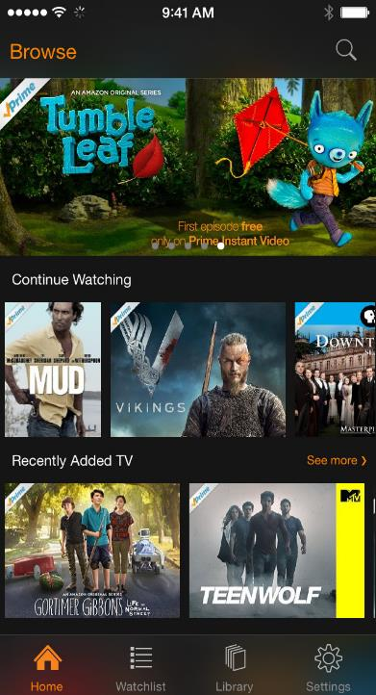
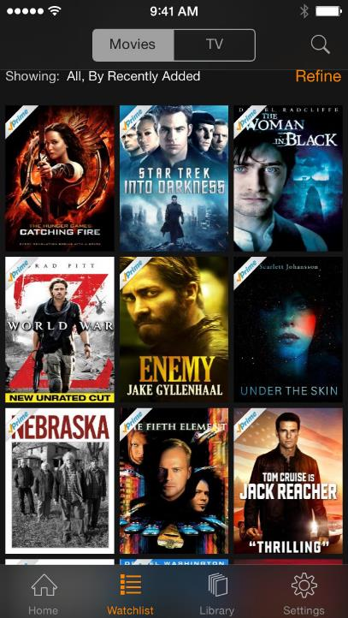
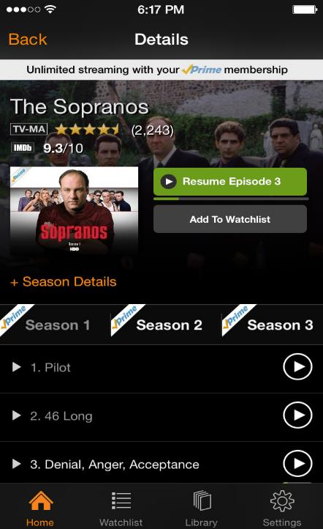
Amazon Video App Screenshots iPhone

Slide 59
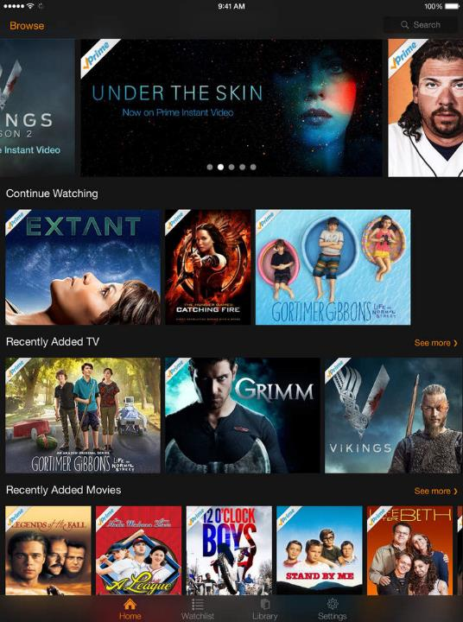
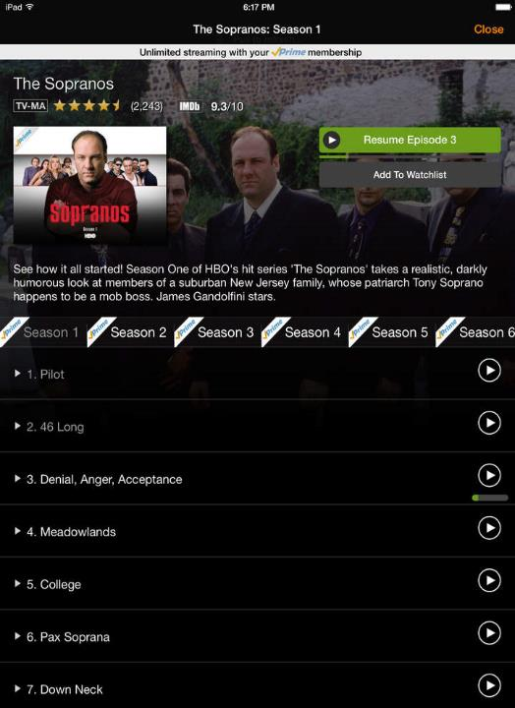
Amazon Video App Screenshots
iPad

Slide 60
Amazon Music - with Prime Music
+ Universal App –
iPhone & iPad
App Description
Prime members enjoy unlimited, ad-free access to:
Over a million songs,
Expert-programmed Prime Playlists,
Ad-free Prime Stations for FREE.
Listen anytime, add to your collection or download to play offline.

Slide 61
Amazon Music – additional features
Deciding what to listen to:
Start an ad-free station by a genre or an artist & enjoy unlimited skips.
The more you listen, the more personalized your stations get.
Find playlists by genre, artist or the top 50s programmed by music experts.
Discover something new with song & album recommendations personalized just for you.

Slide 62
Amazon Music – additional features
Search or Browse through the Prime Music catalog.
Stream your music library from the cloud or play locally on your iOS device:
Music you’ve bought from Amazon – MP3 or AutoRip CDs or Vinyl.
Amazon purchases are stored for free in the Amazon cloud.
Import your iTunes music collection to the Amazon cloud by visiting:
www.amazon.com/musiclibrary on your PC or Mac.
Once imported, the music is available on your iOS device & all other Amazon Music apps.
Play music already stored on your iOS device
Mix with Prime Music songs to make the playlist of your dreams.

Slide 63
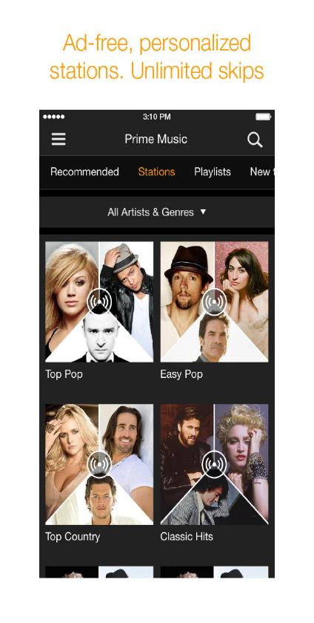
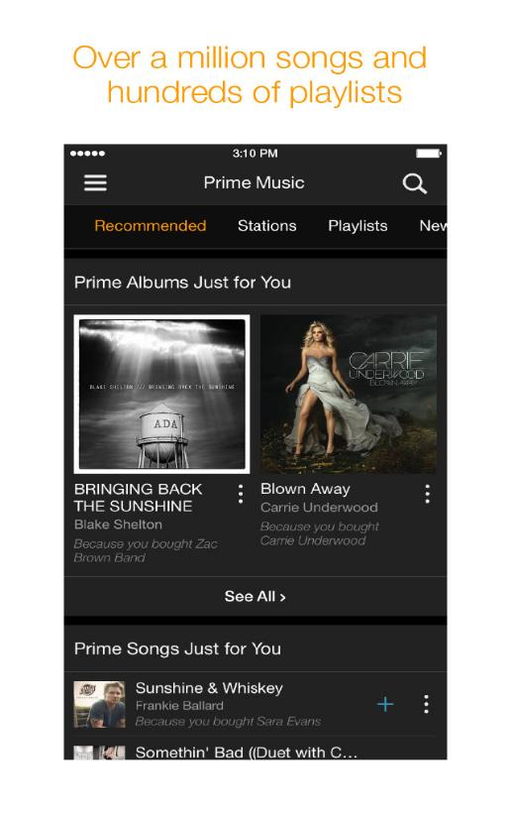
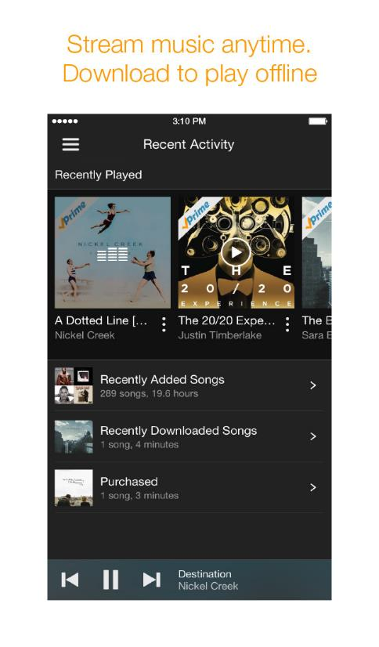
Amazon Music Screenshot iPhone

Slide 64
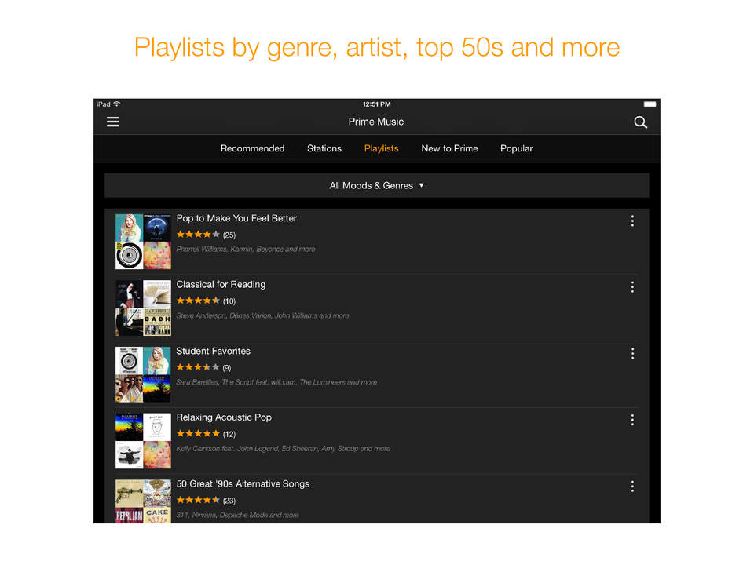
Amazon Music Screenshots iPad

Slide 65
Source of Information http://www.148apps.com/
REVIEWS
NEWS
NEW APPS
PRICE DROPS
TOP LISTS
TIPS & GUIDES
FEEDS
ABOUT
Search Bar
Top List Categories
Top Apps List
Top Paid iPhone Apps
Top Free iPhone Apps
Top Paid iPad Apps
Top Free iPad Apps
Top Free Apple Watch Apps
Based on downloads by all Device users in the United States.

Slide 66
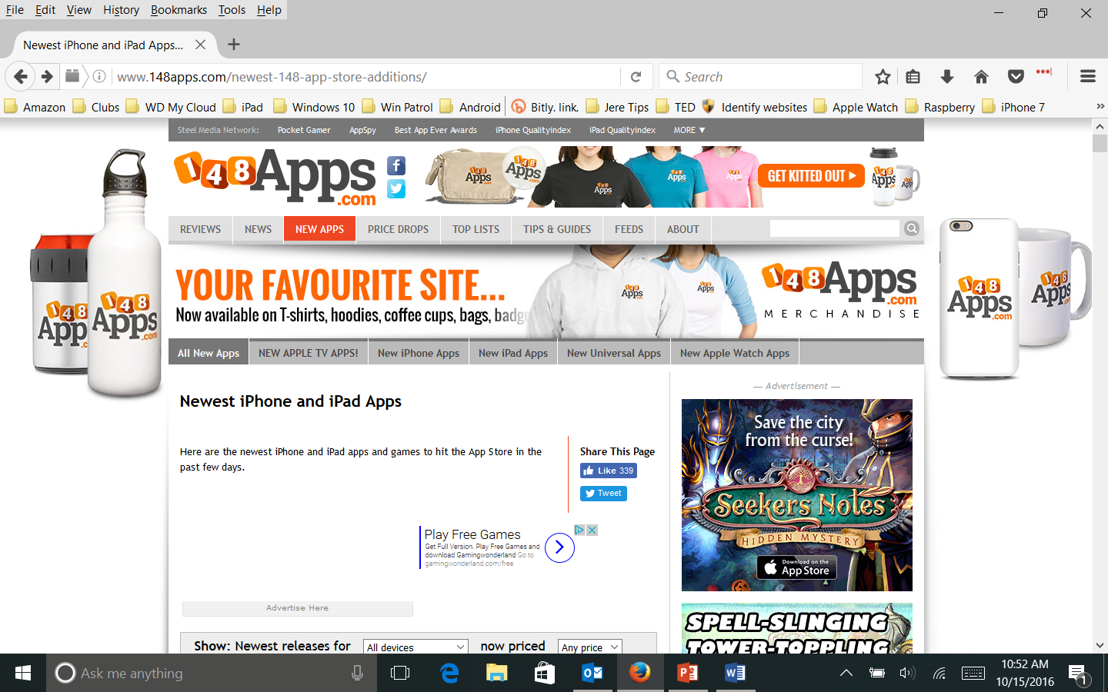

Slide 67
148Apps
Launched in July of 2008.
Purpose -to provide insight into the very best in iOS applications
Goal - sort through the best of the best & provide you with the information you need to choose
In addition to the reviews & news, we keep track of:
what’s selling,
what’s new
what prices are dropping in the iTunes App Store.

Slide 68
iOS Facts about Apps iPhone
 | Screens | Folders Per Screen |  | Total Folders | Apps Per Folder |  | Total Number of Apps
 | 15 | 24 |  | 364 | 135 |  | 49,140
The total number of folders / apps an iPhone/iPad depends on the:
model, screen size, version of the iOS.

Slide 69
I recommend
Do not get Apps for iOS devices except from Apple App Store.
The difference in review processes, apps from the App Store are generally safe;
apps from Google Play can be more worrisome.
Being Available on the App Store means:
paying a yearly fee ($99)
30% of all the profits on your app.
The App Store guidelines are so incredibly tight.
Any App that interacts with system files is flat-out rejected.

Slide 70
Jere Minich - Leesburg, Florida
APCUG Advisor Region 5
Email - jminich@apcug.org

